Slide 1
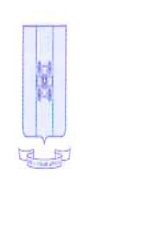

Italian Capitalism and Global Competition - Economics Scenario Analysis
Milan, Italy – 27 June 2015
Catherine L. Mann
OECD Chief Economist

Slide 2
Road Map
  The global outlook
  Europe: a lagging region (starting to catch up?)
  Italy: a laggard within Europe (signs of a pick-up?)
  Structural factors holding back improved economic performance in Italy

Slide 3
Outlook
Global growth is projected to strengthen, though remaining below long-run averages
Reduced fiscal drag— but need better balance
Monetary easing—for 50% of global GDP
Currency depreciation—except US
Lower oil prices – adds 0.5% to level of global GDP
Real GDP growth
Per cent, seasonally adjusted annualised rate
Source: June 2015 Economic Outlook database.

Slide 4
Despite the prospective improvement, the world economy only rates a “B-”

Slide 5
Why a B-?
Scarring of the labour market persists
Long-term unemployed (more than one year)
Per cent of total unemployed¹
NEET² rates among youth
Per cent of youth population aged 15-29
Three-quarter moving averages, not seasonally adjusted.
Not in employment, education or training.
Source: OECD calculations based on quarterly national labour force surveys.

Slide 6
Why a B-?
The investment recovery lags previous cycles
Business investment in different cycles
Cyclical peak in OECD real business fixed investment=100
(date of peak indicated)
Sluggish investment means:
● Labour scarring
● Stagnant incomes, rising inequality
● Slower diffusion from innovation frontier
● Slower potential growth
Source: June 2015 OECD Economic Outlook database.

Slide 7
Focus in on Europe and Italy

Slide 8
Europe
The euro area has been a laggard since the crisis
GDP per capita
Volume index, 2008 = 100
Unemployment rates
Per cent
Source: June 2015 Economic Outlook database; OECD National Accounts database’; OECD calculations .

Slide 9
Italy
Investment in Italy has been especially hard-hit by the crisis and fiscal consolidation
Private non-residential and government
fixed capital formation
Volume index, 2008 = 100
Capital stock excluding housing
Volume index, 2000=100
Source: June 2015 OECD Economic Outlook database.
Notes:
Business and government investment have been worse-hit in Italy than other major economies (left-hand chart), and the non-housing capital stock has even begun to decline in Italy (right-hand chart).
Investment has declined by around 30% since the start of the crisis, a decline unmatched by other OECD countries. Investment seems to have levelled off in early 2015 as economic prospects improve. The recent policy actions by the government to create a secondary market for non-performing loans currently in banks balance sheets, which are restricting credit supply to private firms, and the planned increase in public investment should offer additional support to the recovery in investment.

Slide 10
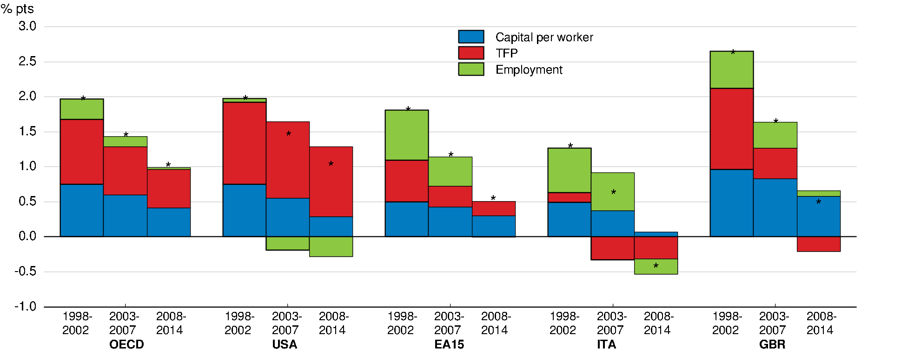
Italy
Potential growth has slowed in most major advanced economies, but especially in Europe and above all in Italy
Contributions to average annual percentage change of potential GDP per capita
Source: June 2015 OECD Economic Outlook database.
Notes:
As a result of structural problems potential output growth has slowed, especially in Italy.
Declining capital per worker, employment rate and labour efficiency are the major cause of the slow down in potential output growth, which is close to zero today.
To raise potential output growth the government will need to push forward its comprehensive plan of structural reforms, which will lead to higher sustainable and more inclusive growth.
The government is implementing the Jobs Act. This is a major reform drastically improve the functioning of the Italian labour market by decreasing duality, lowering costs for dismissal and strengthening the unemployment benefit system
More need to be done to enhance the educational system, promote investment and innovation and the efficiency of the public administration.

Slide 11
Italy
But there are signs of an
incipient economic recovery
Real GDP growth
Seasonally adjusted annualised rate, per cent
Source: June 2015 OECD Economic Outlook database.
Notes:
In 2014, the decline in GDP growth slowed considerably as export performance improved and private consumption revived.
This positive trend continued in 2015Q1 as GDP increased by 0.3% with respect the previous quarter, the largest quarterly increase in the latest four years.
Cost-competiveness gains are beginning to reverse external market share losses. Latest data reveals that during Jan-Apr 2015 exports and imports were, respectively, 4.6% and 4% higher than in the previous year period. Private consumption is being supported by employment and real wage gains, although it slowed down in 2015Q1.
Investment growth is finally showing some signs of recovery, which however remains uncertain reflecting still large spare industrial capacity, restricted credit supply, and past public-investment cuts to achieve budget targets.
GDP growth is set to increase to 0.6% in 2015 and 1.5% in 2015, and price and wage inflation pressures are expected to remain moderate because of large but declining slack in output and labour markets. The external sector is projected to continue to support GDP growth and the current account surplus is poised to reach more than 3% of GDP

Slide 12
Italy
Unemployment is still high, but there are more jobs, and more confidence among job seekers
Unemployment rate
Per cent
The rate would already be lower but for the (welcome) pick-up in labour force participation since 2011
Source: June 2015 OECD Economic Outlook database.
Notes:
The labour market is turning. Latest data suggests that unemployment may have peaked; in April unemployment was to 12.4% against 12.6% the months before and 12.5% in April 2014. The unemployment rate is still well above the NAIRU, estimated to be 9%.
There are signs that labour market participation is rising as previously discouraged people are trying to finds jobs again. The labour market inactivity rate dropped to 35.8% in April 2015 from 36.5% the year before.
Youth unemployment although on a downward path is still unacceptably high ay more than 40%
The government is trying to tackle the structural challenges of the Italian labour market and is currently implementing the “Jobs Act”. This reform has the potential to drastically improve the labour market by reducing duality and providing universal unemployment benefits, thus increasing risk sharing and markedly improving the social safety net
Thanks also to fiscal incentives, the implementation of the recent labour market reform seems to be having already some positive effect. In April 2015 there were about 40% more new open-ended employment contracts than the year before whereas new fixed-term contracts increased by just 1%.

Slide 13
Structural factors holding back Italy
Participation rates are still low,
especially for women
Labour force participation rate
Men Women
%
%
Source: June 2015 OECD Economic Outlook database.
Notes:
Despite these recent progresses, the Italian labour market still faces structural challenges. These are epitomised by low labour force participation, which is one of the lowest among OECD countries, especially for women.
A lot still needs to be done to close the gender gaps and encourage female labour force participation; strengthening the provision of good quality care for children and the elderly will help boost female labour supply and reduce entrenched gender inequality.

Slide 14
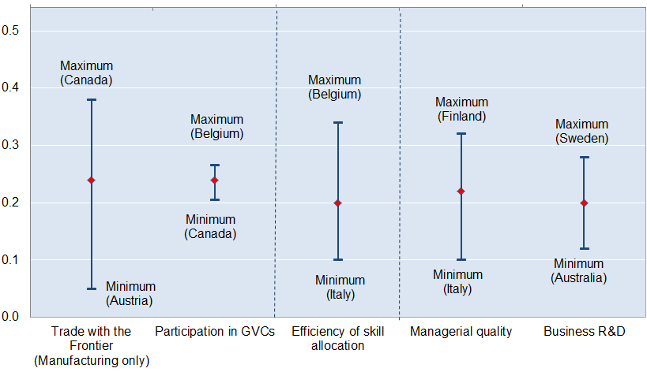
Structural factors holding back Italy
Features of Italy’s business environment hinder the diffusion of innovation…
Estimated frontier spillover (% p.a.) associated with a 2 percentage point increase in MFP growth at the global productivity frontier
Globalisation
Reallocation
Knowledge-Based Capital
Source: Saia, A., D. Andrews and S. Albrizio (2015), “Public Policy and Spillovers From the Global Productivity Frontier: Industry Level Evidence”, OECD Economics Department Working Papers, forthcoming.
Notes:
Innovations at the global frontier do not immediately diffuse to all firms, but at first are only accessible to the most productive firms in an economy (i.e. national frontier firms).
Then, over time they can represent a source of technological diffusion to laggards, but only once the innovations have been adapted to national circumstances by national frontier firms.
This diffusion process is shaped by some key structural factors….
Exposure to the knowledge of – and competition with – global frontier firms, via trade, participation in global value chains (GVCs) etc
Complementary investments in KBC: technological adoption entails significant organisational restructuring, which requires managerial skill, and domestic R&D capabilities to absorb foreign technologies.
Efficient resource allocation: firms need to achieve sufficient scale to cover the fixed costs of entry into international markets but the growth of the most innovative firms – and labour productivity more generally – is undermined by impediments to moving resources to the best performing firms as well as relatively high rates of skill mismatch.

Slide 15
Structural factors holding back Italy
Skill mismatches hold back productivity and wage growth
Potential gains from reducing skill mismatch
Note: The figure shows the percentage of workers who are either over- or under- skilled and the simulated gains to allocative efficiency rom reducing skill mismatch in each country to the best practice level of mismatch. The figures are based on OECD calculations using OECD Survey of Adult Skills (2012).
Source: M. Adalet McGowan and D. Andrews (2015), "Labour Market Mismatch and Labour Productivity: Evidence from PIAAC Data" OECD Economics Department Working Paper No. 1209.

Slide 16
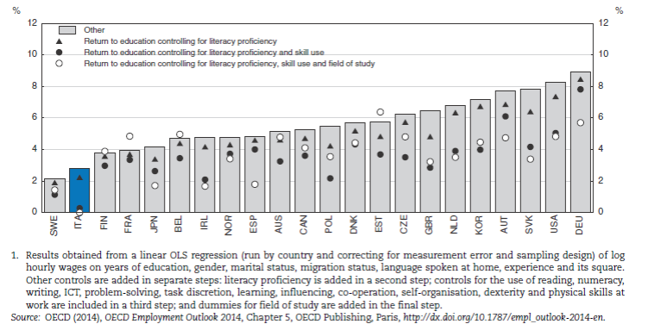
Structural factors holding back Italy
Returns to education are low, creating a negative feedback loop between education, skills, growth

Slide 17
Structural factors holding back Italy
Weak trust in government and regulatory enforcement
Survey measures of perceived corruption and trust in national government
Regulatory enforcement index
Note: Confidence in government score is % of "yes" answers to the question: "In this country, do you have confidence in […] national government?" Government corruption is % of “yes” answers to the question: Is corruption widespread throughout the government?” Data for Chile, Germany and the United Kingdom are 2011 rather than 2012. The regulatory enforcement index ranges from 0 (low enforcement) to 1 (high enforcement). Data for Iceland, Ireland, Israel, Luxembourg, Slovak Republic, Switzerland are not available.
Source: Gallup World Poll and World Justice Project .
Notes:
Italy has suffered for too long from the scourge of corruption, which contributes to low trust in the government and inefficient and wasteful policy decisions.
The government should continue its fight on corruption and the recent establishment of the National Authority Against Corruption goes in the right direction

Slide 18
Summing up
The near-term outlook for the world and Italy is better than the recent past… but
Risk of persistent slow growth equilibrium remains substantial in most major advanced economies, and especially in Italy
Italy has a range of structural policy challenges that must be addressed if long-term growth prospects are to improve
Riforme: Avanti tutta!

